Slide 1
THE 10TH MIDDLE EAST PEDIATRIC ORTHOPEDIC SOCIETY ANNUAL CONFERENCE 2023
3-5 November 2023 I Doha, Qatar
SPONSORSHIP PROSPECTUS
Congress Secretariat: MCI Middle East
+971 4 311 6300

Slide 2
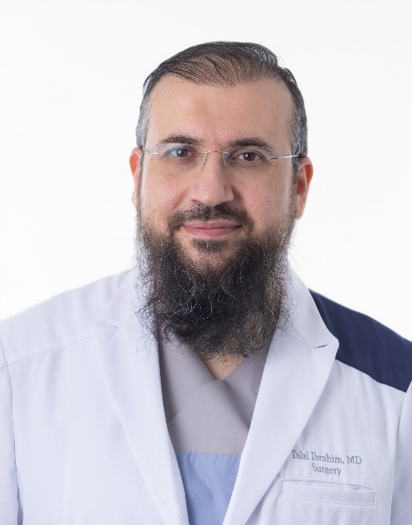
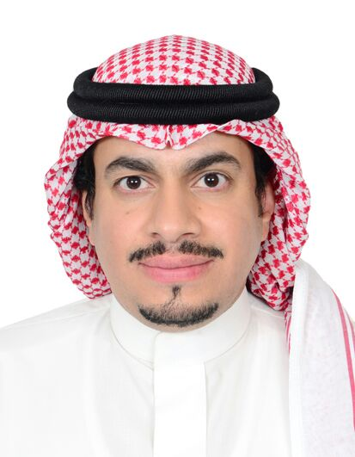
WLCOME MESSAGE
It gives us great pleasure to welcome you to MEPOS 2023, The 10th Middle East Pediatric Orthopedic Society Annual Conference, in Doha, Qatar. The scientific program will provide an excellent learning opportunity and give the most up to date insights in contemporary care by a faculty that has outstanding speakers from the region as well as international world leaders in our field. The keynote speakers will be Dr. Kai Ziebart from Switzerland, Professor Muharram Yazici from Turkey and Dr. Benjamin Shore from the USA who will share their vast experience in pediatric hip surgery. The pre-course will consist of an infant hip course with real babies. There will also be a parallel session for Allied Health Professionals and free paper session for podium and presentations.
It is our sincere hope that as many delegates attend as possible so that we can catch up with old friends, renew acquaintances as well as make new friends and collaborations. Doha is a beautiful city with plenty to see for those who may wish to extend their stay. Doha recently hosted the FIFA World Cup 2022 and has been chosen as the Arab Tourism Capital for 2023. Both Sidra Medicine and the conference hotel (Hilton) are well located in the city with easy connections, wonderful restaurants and close proximity to the Corniche for those who wish to walk, run or cycle.
The organizing and scientific committee extends a sincere welcome to you all in Doha for what promises to be an excellent meeting.
Thank You
Dr. Talal Ibrahim (Chair)
Consultant Pediatric Orthopedic Surgeon & Division Chief of Orthopedic Surgery, Sidra Medicine, Doha, Qatar
Dr. Ali Al Dossari (Co-Chair)
Consultant Pediatric Orthopedic Surgeon & Head of Pediatric Orthopedic Chapter – Saudi Orthopedic Association, King Saud Medical City, Riyadh, Kingdom of Saudi Arabia
2

Slide 3
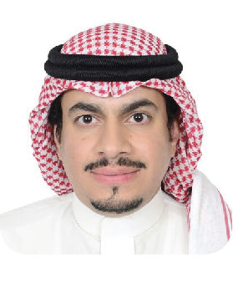
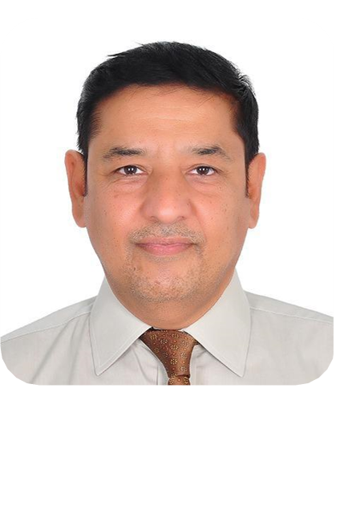
SCIENTIFIC & ORGANIZING COMMITTEE:
DR. SATTAR ALSHRYDA
UNITED ARAB EMIRATES
DR. IBRAR MAJID
UNITED ARAB EMIRATES
DR. ALI AL DOSSARI
KINGDOM OF SAUDI ARABIA
DR. MARC SINCLAIR
UNITED ARAB EMIRATES
DR. MICHAEL UGLOW
UNITED ARAB EMIRATES
PROF. GAMAL HOSNY
EGYPT
PROF. AYMAN JAWADI
KINGDOM OF SAUDI ARABIA
DR. IFTIKHAR MUKHTAR BAHRAIN
DR. SALEH ALSEIFI
KUWAIT
DR. SIMONE BATTIBUGLI
UNITED ARAB EMIRATES
DR. CHRISTIANA SAVVIDOU
UNITED ARAB EMIRATES
PROF. LAS HWAIZI
IRAQ

Slide 4
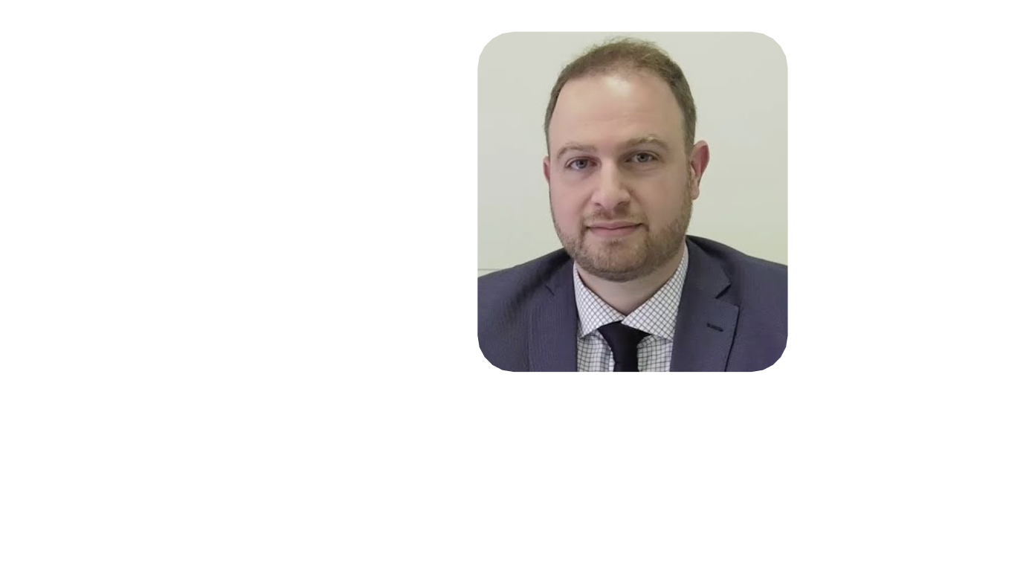
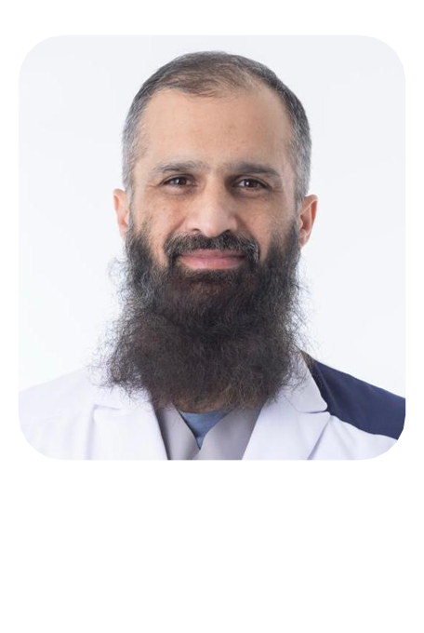
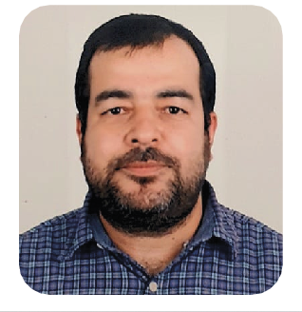
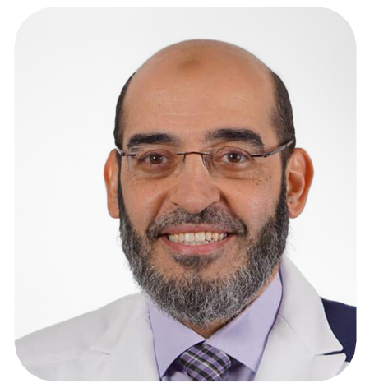
SCIENTIFIC & ORGANIZING COMMITTEE:
DR. FARHAN ALI
QATAR
DR. ABDELMAJID SHEIKH TAHA
QATAR
DR. MUBASHIR WANI
QATAR
DR. ABDELSALAM HEGAZY
QATAR
PROF. TALAL IBRAHIM
QATAR

Slide 5
ABOUT MEPOS
The Middle East Pediatric Orthopaedic Society (MEPOS) has been established by Pediatric Orthopaedic Surgeons practicing in the Middle East region. All members of the society take a special interest in Children's Orthopaedics. The society's aim is to improve the detection, prevention and care of children suffering from musculoskeletal disease in the Middle East.
The affairs of the society are currently managed by an Executive Board consisting of a president, president-elect, general secretary, treasurer, research committee chair, education committee chair and board members elected by the founding members of MEPOS at the 1st Annual meeting in Dubai in October 2014. We welcome all Pediatric Orthopaedic Surgeons and Associated Health professionals with interest in Pediatric Orthopaedics to join the society and actively contribute to its growth. Please do contact us for further information.
5

Slide 6
PROGRAM TOPICS
Infant Hip Course “Hands-on” real babies
Hip: Developmental Dysplasia of the Hip, Slipped Capital Femoral Epiphysis, Cerebral Palsy
Trauma
Case Discussions
Research: Orthotechnology
Free Paper Session
6

Slide 7
WHY PARTNER
Brand Visibility - Increase Brand Awareness
Sponsorship places brands in front of large audiences delivering recognition ensuring that your brand is synonymous within the industry. Given the impressive global impact and reach of MEPOS, your brand would be aligned with positive press and social media coverage before, during, and after the event and deliver unrivalled visibility.
Community Goodwill
Its proven that community goodwill strengthens the business image. Enhance competitive advantage by demonstrating a high
commitment to Corporate Social Responsibility (CSR) through sponsorship of the MEPOS.
Target Market
Target both public, corporate visitors, VIP’s and government officials. As a sponsor you will be able togain exclusive opportunities to engage one on one with key influencers and leaders within the market place.
Thought Leadership
Position yourself as a thought leader in the industry. Promote your companies market position and expertise to the most influential decision makers fromtheindustry, alongside the key representatives from the governments across the globe.
7

Slide 8
Network Expansion
Given the global presence at such an event, sponsorship delivers an opportunity to develop business relationships and generate quality leads. The event will be a great channel to actively
network with participants and other professionals.
ROI Generation
Although making profit is not the primary goal, sponsoring an event can generate a high Return on Investment (ROI).
Cultivate Credibility
Enhance trust and establish rapport with the audience as an industry contributor and key player.
Increase your Reach
Opportunity to reach out to a larger audience across a mix of communications channels including email, direct, digital,
social media and content marketing and public relations.
Reconnect and Engage with Audience
Being an event sponsor is a great opportunity to connect with international leaders and professionals from various
backgrounds.
8

Slide 9
EXHIBITION
PREMIUM EXHIBITOR
Stand type | Size | Tariff (USD)
Shell Scheme | 3 x 3 sq mts | USD 6,000
The Premium Exhibitor rental fee includes:
Two complimentary registration to the Congress Scientific Sessions
(9 sq mts) Shell Scheme Structure
2 Exhibitors Badges
Fascia Name
Basic booth lighting
One 13amp Power socket
One Table 2 Chairs
Exhibitor listing on the website and in the final program
EXHIBITOR
(TABLE TOP - INCLUDES 1 TABLE AND 2 CHAIRS)
Stand type
Size Tariff (USD)
Table Top 2 x 2 sq mts
USD 4,000
All furniture and lighting need to be ordered at an additional cost
10

Slide 10
AVAILABLE PACKAGES MARKETING & PROMOTIONS
(*Price available upon request)
Gala Dinner or Faculty Dinner Sponsor
Dinner invitation will include sponsor’s logo
5 dinner tickets for sponsor’s guests
Promotional material to be placed on every table (material to be provided by the sponsor)
Roll-up banner near venue entrance (to be provided by sponsor)
Acknowledgment as Gala Dinner Sponsor in conference materials and during the dinner
Clothing Sponsoring Registration Staff
Our registration staff is your moving branding tool.
Clothing Sponsoring Badge Scanning Staff
At all entrances our staff wear clothing showing your logo.
Clothing Sponsoring High Visibility Safety Jacket
During the construction work everyone wears high visibility safety jackets with your logo
Sponsors
Sponsors
Sponsors
Sponsors
Sponsors
Workshops
Workshops are excellent opportunities for knowledge sharing, marketing and product branding - Timeslot for a presentation (per hour)
Standard equipment (microphone, screen, beamer, chairs) is included. Catering and additional AV equipment should be ordered separately.
Conference Bag Sponsor
Sponsors Logo
11

Slide 11
Conference Lanyard Sponsor
Satchel Insert
The inclusion of a one-page promotional insert in the Congress bags. Inserts to be supplied by the Sponsor and approved by the Congress Secretariat.
Event Mobile App (Exclusive)
The mobile application will be provided to delegates free of charge and will be available for most iOS and Android mobile devices. The mobile app will include the full scientific programme, the exhibition Foorplan including exhibitor biographies, and general Congress venue and local information. Timely updates about any onsite programme changes or important an- nouncements will be sent through the app via notification alerts.
As the exclusive sponsor of the mobile app, you will:
Have your logo and 50-word write-up displayed in a Sponsored App Section
Have the opportunity to have one (1) pinned Promoted Message + one (1) post per day
Be acknowledged as the Sponsor of the Onsite Mobile App with your logo in the Onsite Programme

Slide 12
Congress WIFI (Exclusive)
Wireless internet will be available throughout the venue at no charge allowing delegates to use the Congress Onsite Mobile App, access abstracts online and connect with other delegates and colleagues.
As the exclusive sponsor of the free wireless internet service, you will:
Have your logo displayed on all relevant signage associated with the wireless internet
Be acknowledged as the Sponsor of the Wireless Internet with your logo in the Onsite Programme
USB Sticks of Abstracts (Exclusive)
Each registered delegate will receive a USB memory stick with the collection of all abstracts submitted and accepted for presentation at the Congress. It will be handed out when the delegates pick up their Congress bags.
As the exclusive sponsor of the USB stick of Abstracts, you will:
Have your logo displayed on the outside of the USB stick
Be acknowledged as the Sponsor of the USB stick of Abstracts with your logo in the Onsite Programme
Lunch Break
As the sponsor of one of the lunch breaks, you will:
Have tabletop cards with your logo on all food and beverage stations during your selected lunch break.
Be acknowledged as the Sponsor of the selected lunch break with your logo in the Onsite Programme.
Device Charging Station
The charging station will provide a quick charge for tablets and mobile phones while guaranteeing they will not be overcharged, so that all devices are always ready for use. It may be located at the Sponsor’s stand, in the internet area or in the common areas of the Congress.
13

Slide 13
PAST SPONSORS AND EXHIBITORS
14

Slide 14
Information Kiosk
Kiosks in which the participants can consult all the information about the Congress. The sponsor’s logo will be affixed to the kiosk.
Promotional E-Mail
Opportunity to promote your company and its participation in the event (Symposium, Stand, etc.) in a mailer to the people who have pre-registered for the congress.
15

