Slide 1
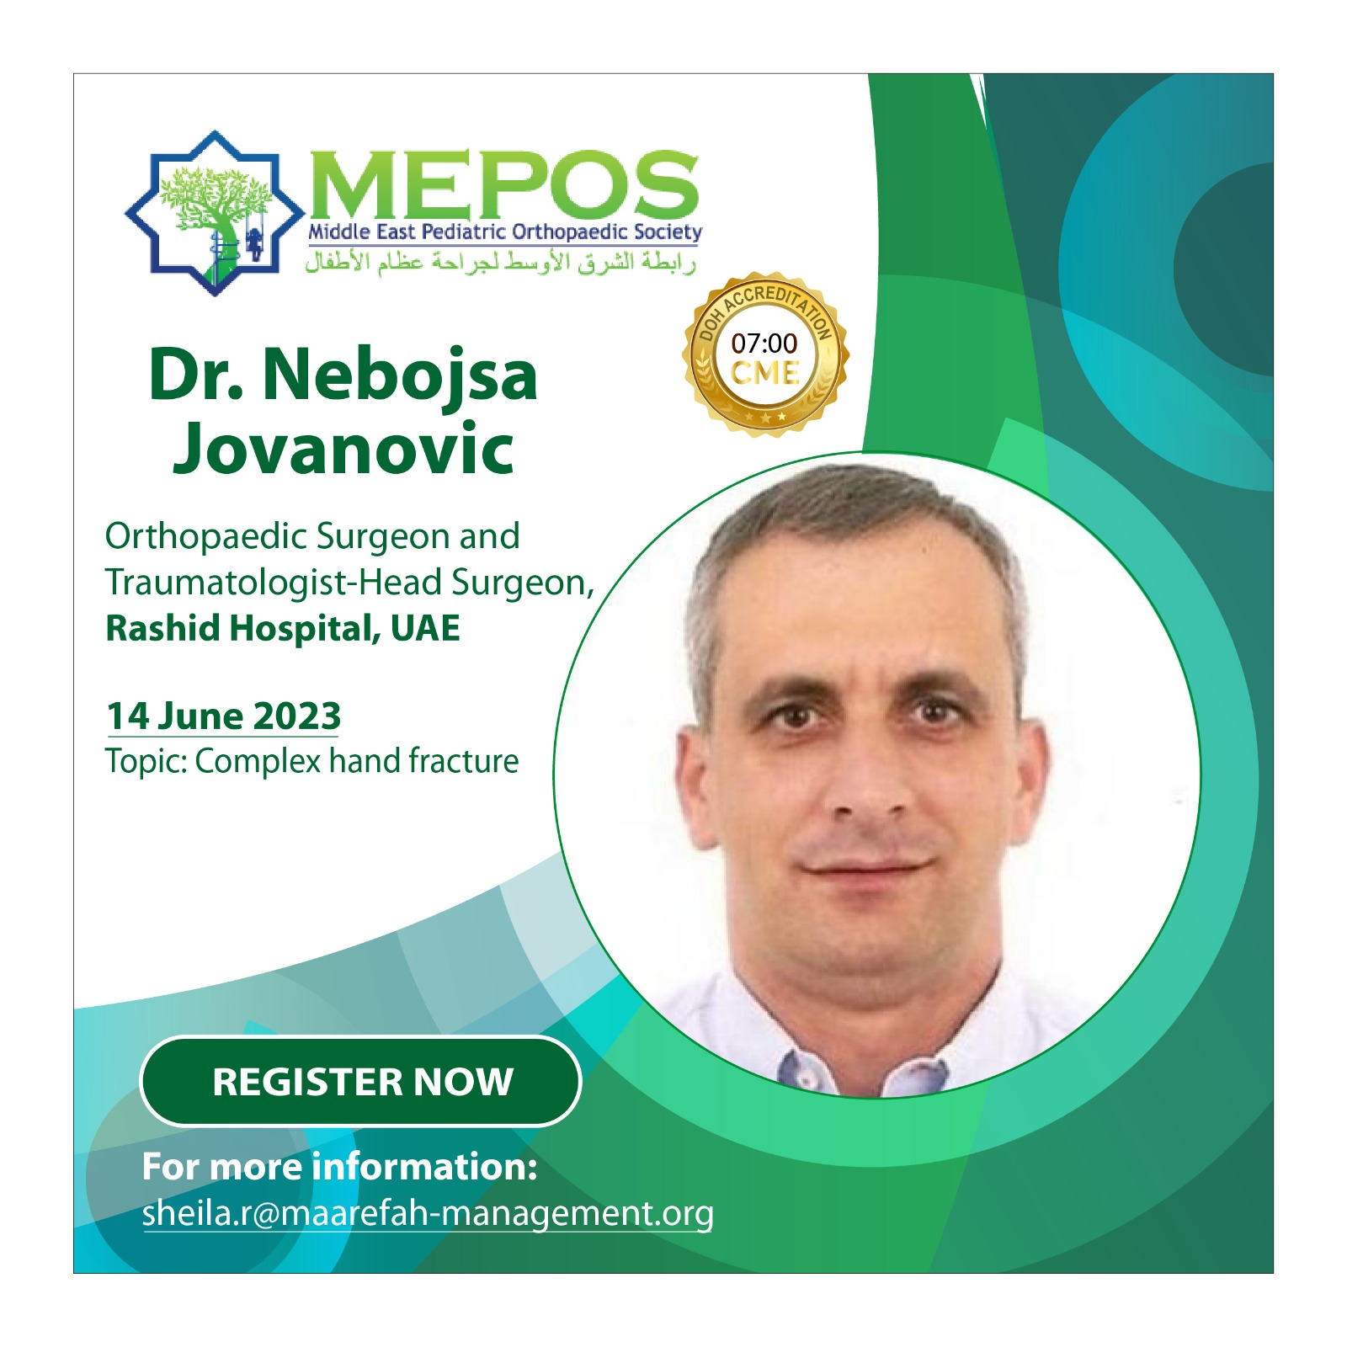
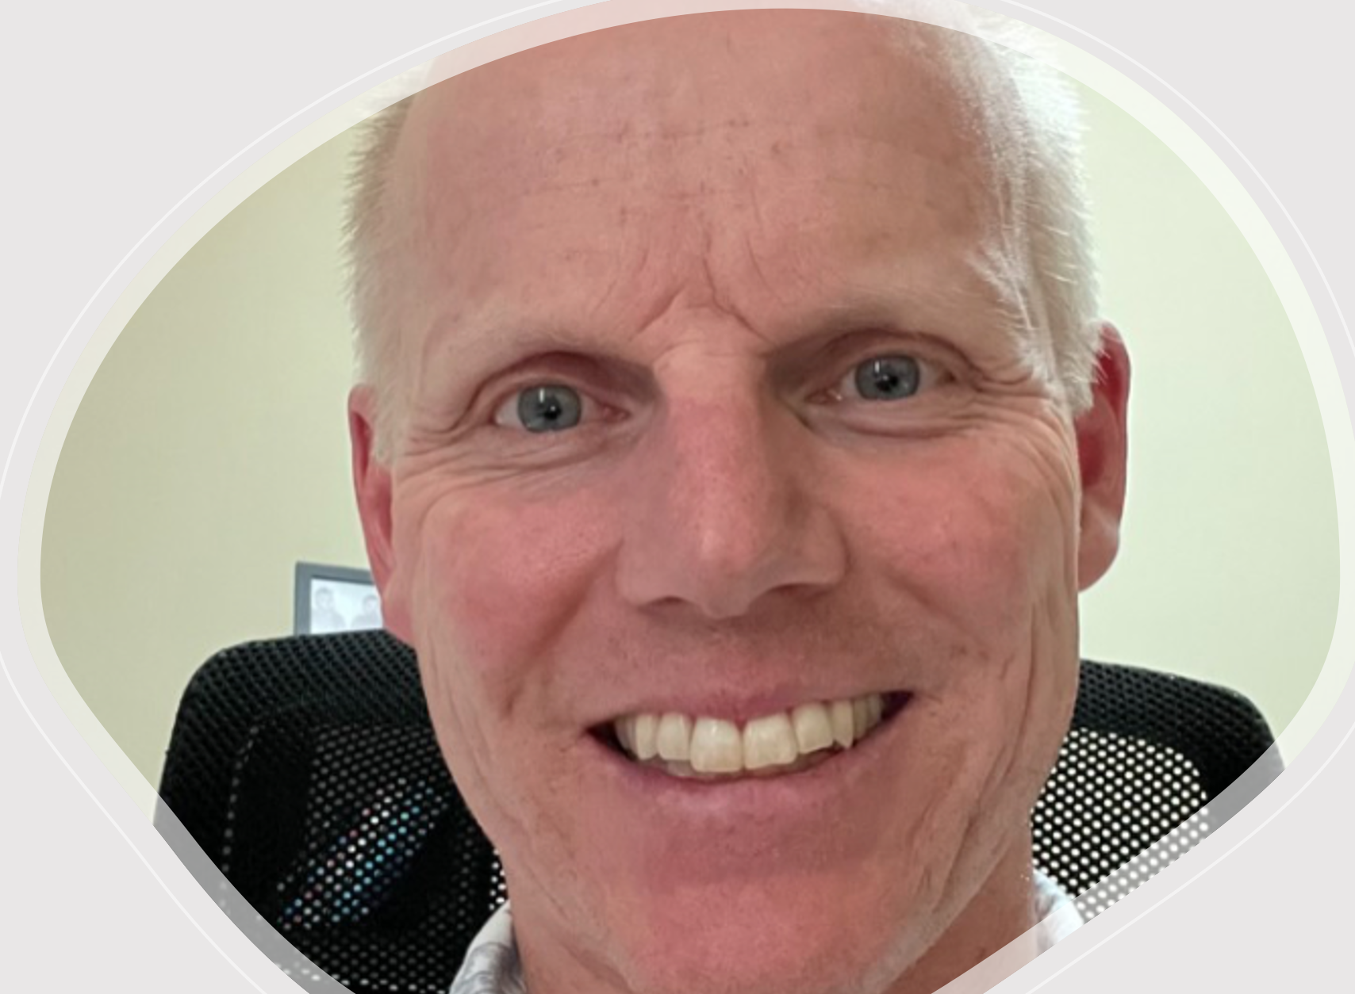
MEPOS-WEBINAR
SERIES
Dr. Ken Kontio
Pediatric Orthopedic Surgeon
SKMC, Abu Dhabi
20 November 2023
PATELLAR INSTABILITY
2023-2024: Free of charge
mepos.me

Slide 2
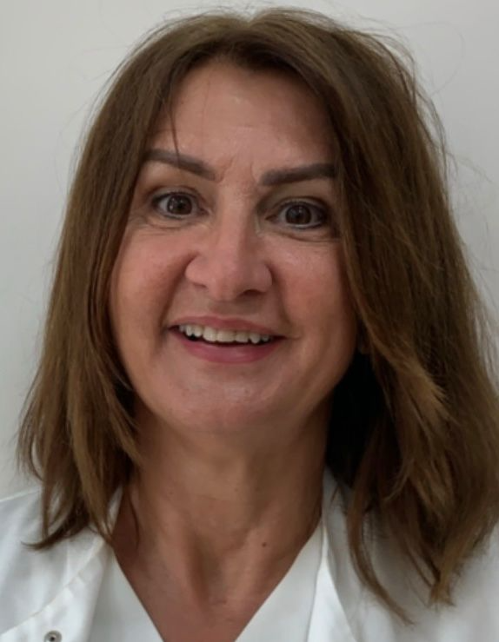
MEPOS-WEBINAR
SERIES
Dr. Nina Dordevic
Pediatric Orthopedic Surgeon
Mediclinic, Al Ain & Abu Dhabi
22 January 2024
DDH: Early Diagnosis & Management
2023-2024: Free of charge
mepos.me

Slide 3
MEPOS-WEBINAR
SERIES
Dr. Ken Kontio
Pediatric Orthopedic Surgeon
SKMC, Abu Dhabi
26 February 2024
INTRAARTICULAR KNEE INJURY
2023-2024: Free of charge
mepos.me

Slide 4
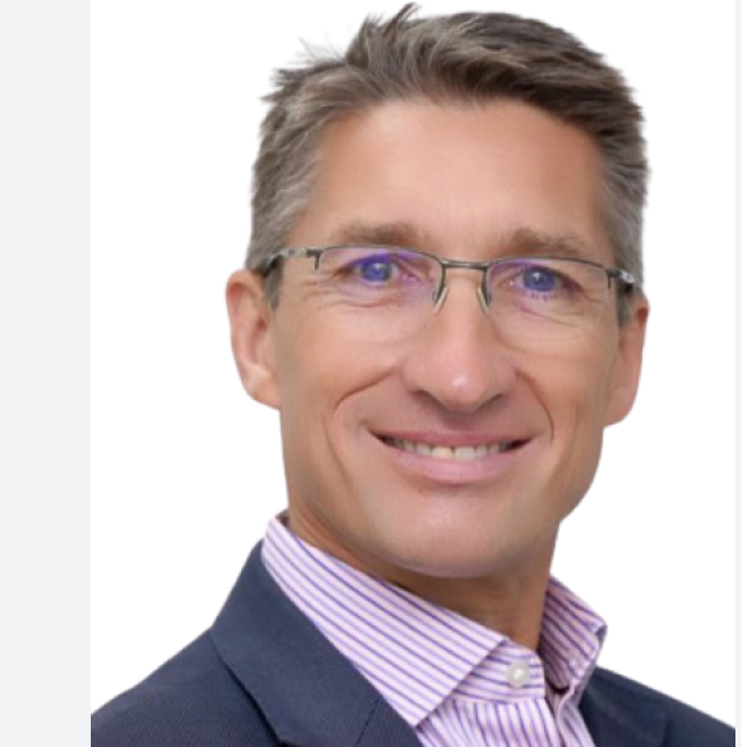
MEPOS-WEBINAR
SERIES
Dr. Michael Uglow
Pediatric Orthopedic Surgeon
Burjeel, Abu Dhabi
22 April 2024
OSTEOGENESIS IMPERFECTA::
LOWER LIMBS
2023-2024: Free of charge
mepos.me

Slide 5
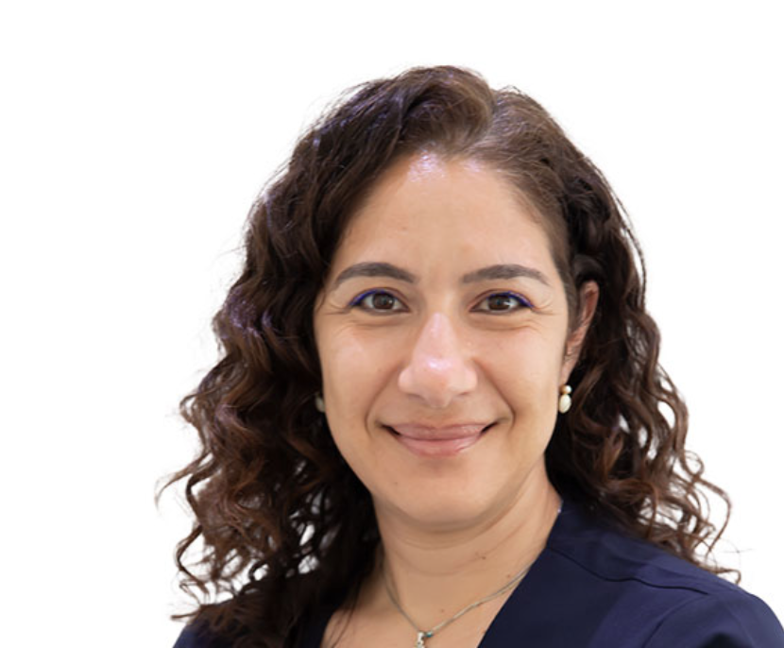
MEPOS-WEBINAR
SERIES
Dr. Christiana Savvidou
Pediatric Orthopedic Surgeon
Emirates Hospital, Dubai
24 June 2024
OSTEOGENESIS IMPERFECTA:
UPPER LIMBS
2023-2024: Free of charge
mepos.me

Slide 6
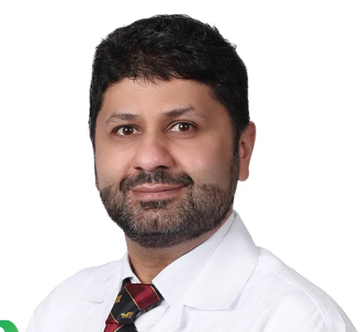
MEPOS-WEBINAR
SERIES
Dr. Assad Quresh
Pediatric Orthopedic Surgeon
American Hospital, Dubai
26 August 2024
HIP RECONSTRUCTION:
CEREBRAL PALSY
NON AMBUTATORY PATIENTS
2023-2024: Free of charge
mepos.me

Slide 7
MEPOS-WEBINAR
SERIES
Dr. Michael Uglow
Pediatric Orthopedic Surgeon
Burjeel, Abu Dhabi
23 September 2024
OSTEOGENESIS IMPERFECTA::
PT + ORTHOTICS
2023-2024: Free of charge
mepos.me

Slide 8
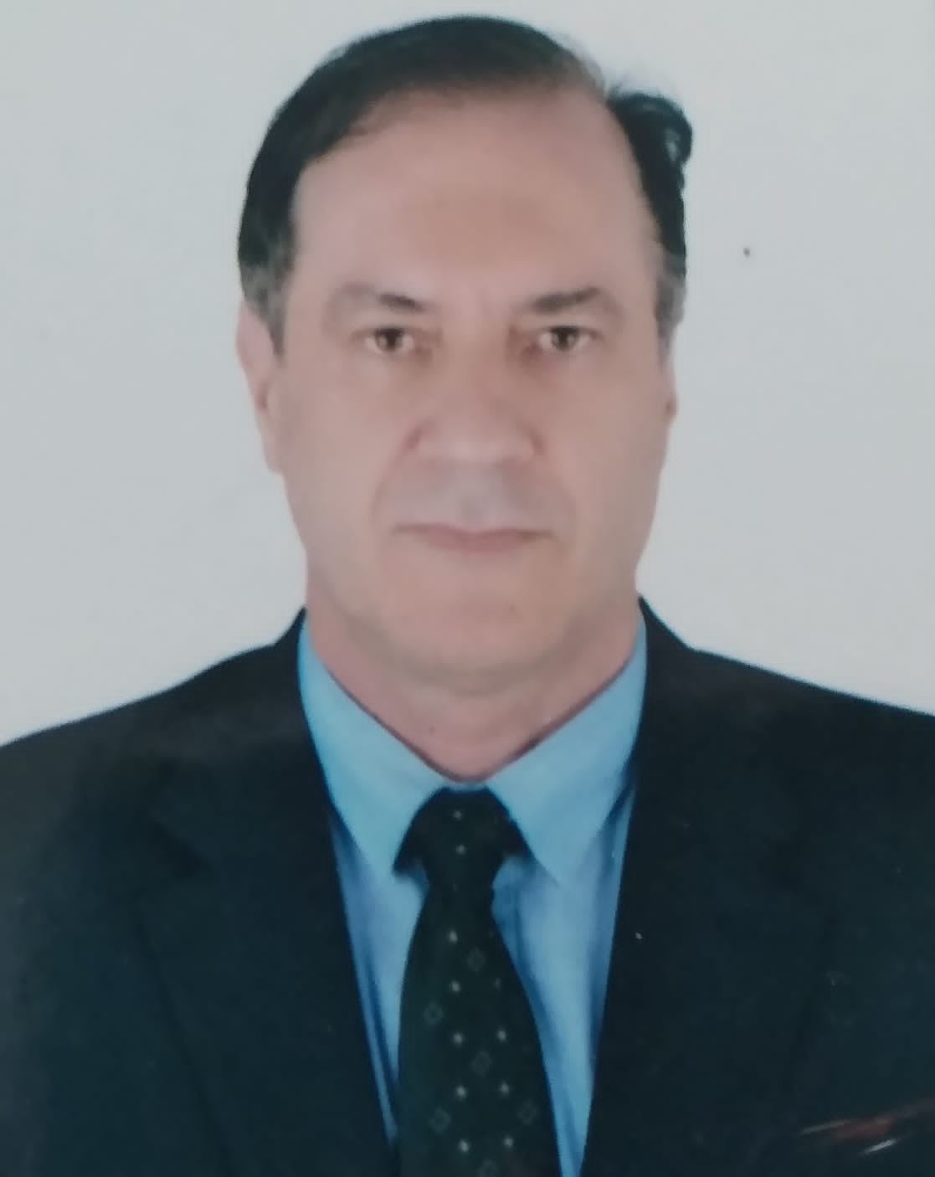
MEPOS-WEBINAR
SERIES
Dr. Edilson Forlin
Pediatric Orthopedic Surgeon
Mediclinic, Dubai
18 November 2024
SPINA BIFIDA:
MANAGEMENT & PITFALLS
2023-2024: Free of charge
mepos.me

Slide 9
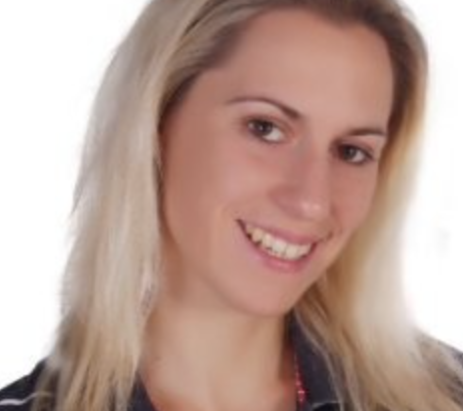
MEPOS-WEBINAR
SERIES
Stephanie Berkhout
Pediatric Physiotherapist
Salma Rehab Hospital, Abu Dhabi
9 December 2024
SPINA BIFIDA:
PT/ OT/ Orthotics
2023-2024: Free of charge
mepos.me

Slide 11
